Slide 1
Online Exam Portal

Slide 2

Contents
Login System
Uploading to database
Retrieve from database
List of users
User management
Exam portal
Result

Slide 3
Problem Statement
Online Exam portal

Slide 4
Introduction
A System with:
Pyhton
MySql
Active Connection

Slide 5
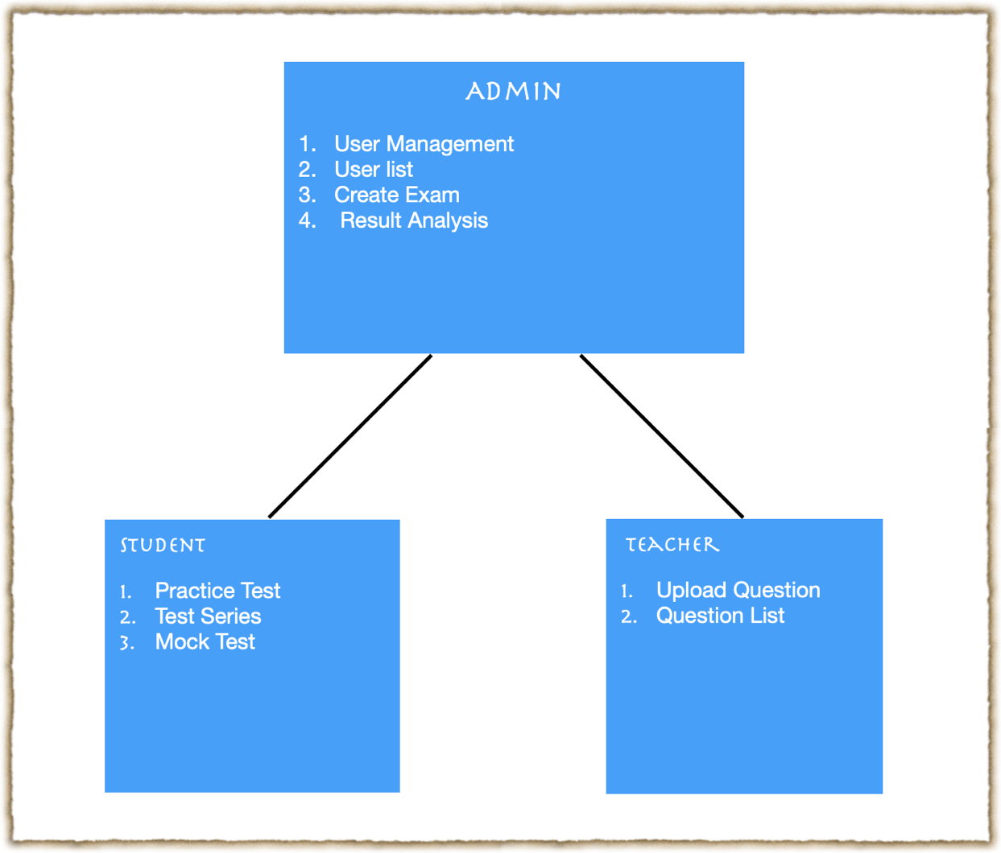
System Architecture

Slide 6
Implementation
Conducting mock on basis of the particular subject choosed by student and calculate result.
1. Take number of questions and Subject of questions to be displayed as input from user
2. Fetch the question details from database on the basis of the input using flask mysqldb cursor
3. Send the data fetched to the exam display HTML page along with length of data i.e. no. of questions
4. Test is started and Questions are displayed.
5. As the test is performed the options selected by the users are dynamically stored in a javascript array.
6. On submit the array is passed to the python flask route using ajax.
7. Sent data if fetched using request.json method
8. The percentage result is calculated according to the no. of questions i.e the length of data.
9. This calculated result is stored in Databases accprding to the student prn, subject and year using cursors to be used for analysis and result is sent back as jsonify object to ajax.
10. Result is displayed along with the list of Questions with correct answers to be reviewed by th user.

Slide 7
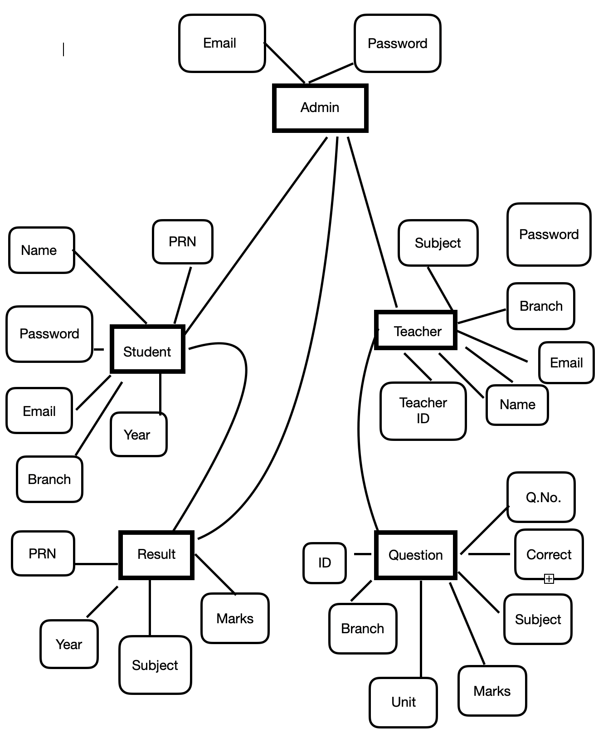
Methodology

Slide 8
Software & Hardware
Requirements:
MySQL
Processors : Intel Atom Or Intel core i3
Disk space : 1 GB for software
Operating system : Windows 7 and Later, linux , MacOS .
Python Version 2.7.x or later.

Slide 9
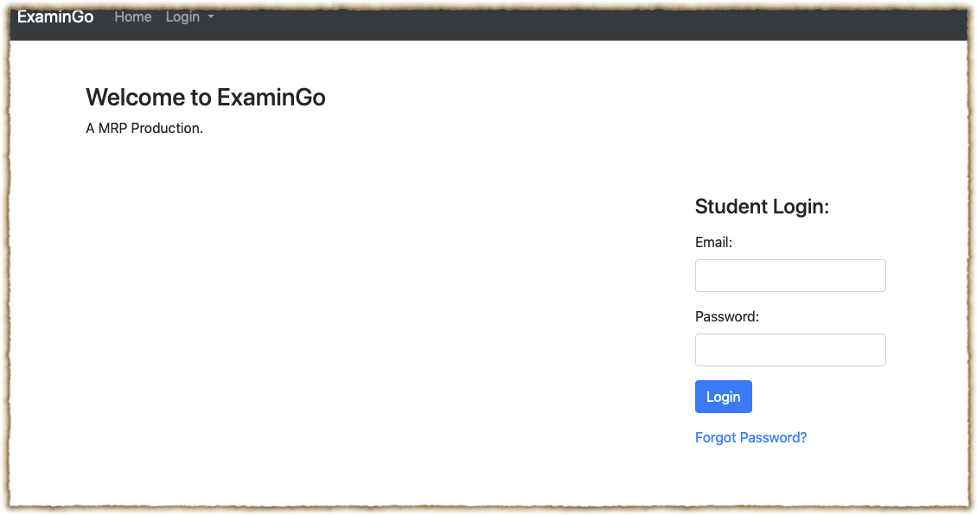
User Login

Slide 10
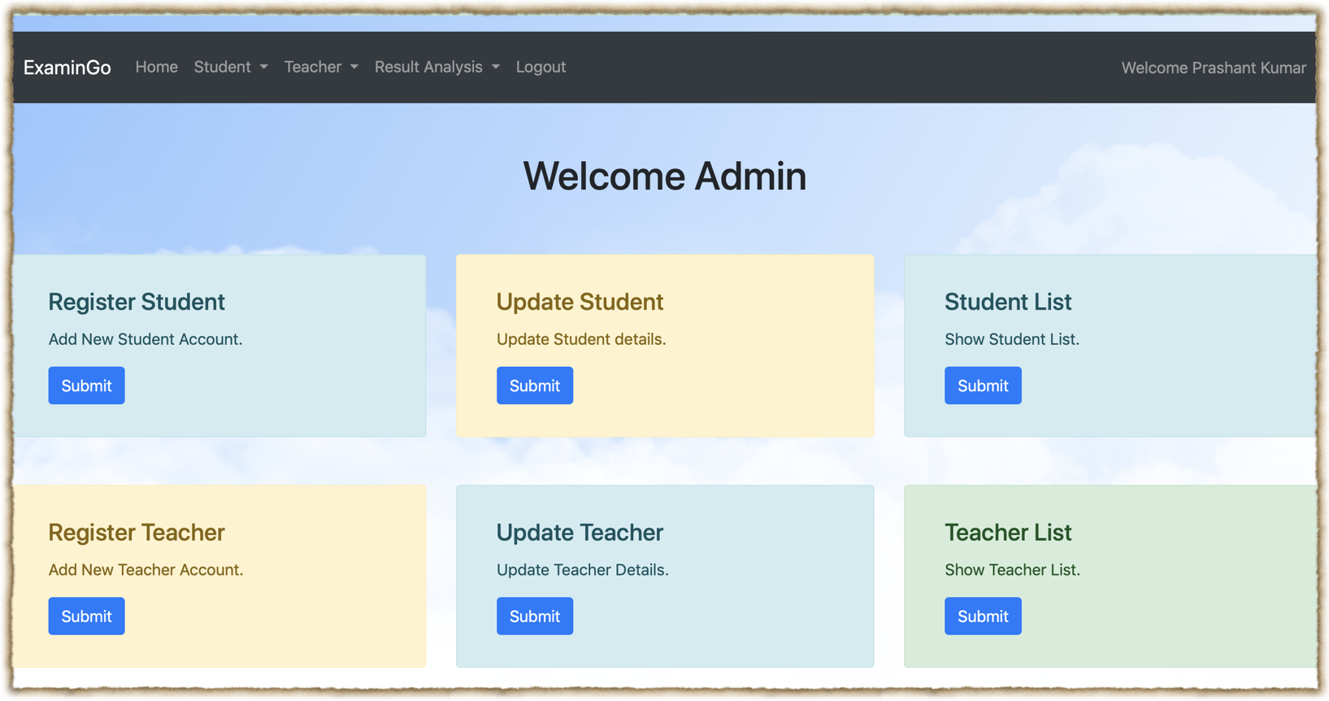
User Management

Slide 11
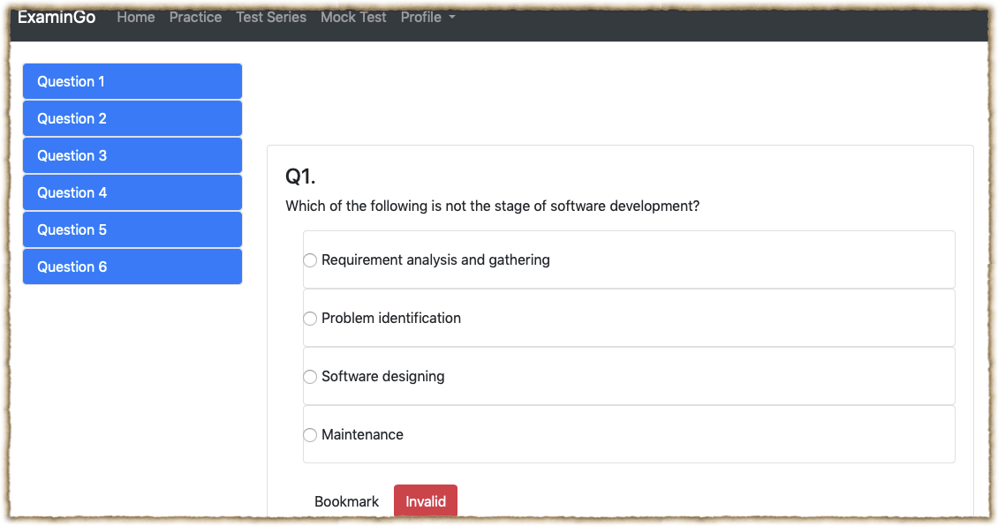
Exam Portal

Slide 12
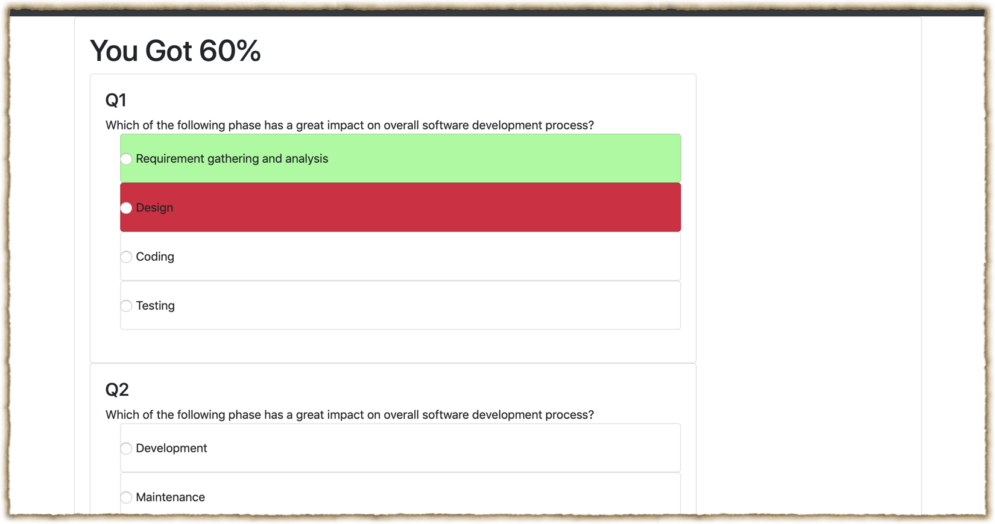
Result

Slide 13
Conclusion :
Successfully Implemented python with help of Flask and MySQL

Slide 14
References :
W3Schools.com
google.com

Slide 15
Thank You..

Slide 16
“Don’t let what you cannot do interfere with what you can do.”
–John Wooden

